Slide 1
Performance Appraisal
Defined
An organization’s performance appraisal system is defined as a process which generates valid information about employee work effectiveness for the purpose of making informed human resource decisions.

Slide 2
Why
Performance Appraisal?
Employees must understand the behavioural requirements of the job.
Employees need to know where they stand in terms of their performance.
Employees’ work must be evaluated for its contributions to organizational goals.

Slide 3
Why
Performance Appraisal?
Valid information about performance levels of the employees should be used to make decisions about salary increases, promotion, bonuses and training needs.
Employees should have a clear understanding of what the organization expects in performance.

Slide 4
Why
Performance Appraisal?
Managers can use the performance appraisal system as a motivational tool.
An effective appraisal system creates many opportunities for managers to interact with their subordinates about performance standards, organizational goals and personal job interests.

Slide 5
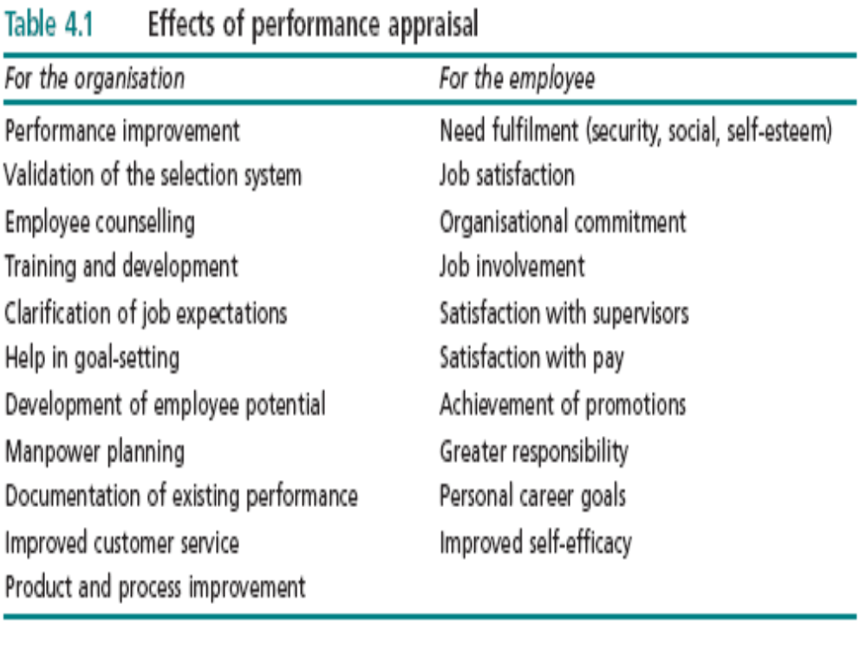

Slide 6
Appraisal Terms & Problems
DEFICIENCY
VALIDITY.
RELIABILITY
STABILITY
CONSISTENCY
MEASURED PERFORMANCE
ACTUAL PERFORMANCE

Slide 7
Performance Appraisal Problems
Deficiency:
  represents actual performance that is overlooked because the evaluator ignores it or the system fails to capture.
    An example : the appraisal system that tracks the frequency of calls handled by representatives& fails to capture the quality of the service .

Slide 8
PERFORMANCE
Unreliability problems
1. Situational factors affecting the evaluator, such as mood or timing of the evaluation
2. Disagreement between evaluators or inconsistent of methods
3. Temporary personal factors, such as fatigue or ill health of the person being evaluated.
Deficiency problem
Performance overlooked
by the evaluator
Deficiency
True
Assessment
( Valid + Reliable)
Unreliability
Invalidity
Validity problem
Poorly defined task performance
Actual
Performance
Measured
Performance

Slide 9
Performance Appraisal Problems
  Unreliability:
  It stems from the evaluator (s)
  Reliability refers to the constancy and stability of
  performance appraisal results under the same evaluators and similar circumstances of administration.
1. Situational factors affecting the evaluator, such as mood or timing of the evaluation
2. Disagreement between evaluators or inconsistent of methods
3. Temporary personal factors, such as fatigue or ill health of the person being evaluated

Slide 10
Performance Appraisal
Consistency:
i.e. two or more ways of gathering performance produce results which agree
Stability:
It means that performance measuring items should yield the same score at various evaluation periods if the performance characteristic has not changed
It is the property of dependability of results over time.

Slide 11
Performance Appraisal Problems
Validity:
Validity is the proven relationship that exists between a selection device and job criterion
  is the quality of the measuring components in a performance appraisal system i.e. do the components measure what they are supposed to measure?

Slide 12
VALIDITY FORMS
CONTENT
DISCRIMINANT
CONSTRUCT
VALIDITY
CONVERGENT
EMPIRICAL

Slide 13
Forms of Validity
Content validity : The performance appraisal measure are related to the aspects of performance being measured.
  Supervisors and employees agree that the dimensions of
performance measured are related to actual job behaviours.
Empirical validity: Performance measures are statistically related to other important work outcomes.

Slide 14
Forms of Validity
Construct validity : The performance appraisal system derives from a theory of performance behaviour and motivation.
  A firm develops its appraisal program from the expectancy theory of motivation.
Convergent validity: Multiple measures of the same performance dimension yield equivalent scores.
Discriminant validity : Measures of performance using the same method produce different scores for different aspects of performance.

Slide 15
Errors in Performance
Appraisal Reliability
Personal bias
Halo effect
Recency error
Central tendency error
Strictness or leniency errors
Similarity error
Forcing the rating to match other criteria

Slide 16
Errors in Performance
Appraisal Reliability
Personal bias: A stereotype or bias which influence a superior’s rating upward or downward.
Halo effect: Rating an employee on one trait based on other traits. A general impression of an employee based on a single characteristic.

Slide 17
Recency Error:
The emphasis of recent performance examples in making performance assessments
Central Tendency Error:
Assigning average ratings to all employees which causes little variation among ratings.

Slide 18
Errors in Performance
Appraisal Reliability
Similarity Error:
The supervisor has a performance quality in himself which he looks for in subordinates.
Forcing the rating to match other criteria:
Deciding on an overall rating first then going back to adjust ratings on the individual dimensions to justify the overall rating.

Slide 19
OVERCOMING RELIABILITY ERRORS
I. Use Multiple Criteria
Performance appraisal systems should rely on several performance dimensions or criteria.
The more complex the job ,the greater the need for multiple assessment criteria.
Managers should target core job behaviours that are essential to good job performance.

Slide 20
OVERCOMING RELIABILITY ERRORS
II. Emphasize behaviours rather than traits
Seniority, organizational commitment, reliability, and friendliness may be desirable attributes in employees but they may have little impact on performance.
Multiple raters will have different personal meanings for traits such as loyalty, honor, friendliness and dependability.

Slide 21
OVERCOMING RELIABILITY ERRORS
III. Use Several Raters
As the number of raters used increases, the accuracy of results improves .
The use of 360 degree performance appraisal creates many of the strengths of multiple raters in performance appraisal work.

Slide 22
OVERCOMING RELIABILITY ERRORS
360 degree performance appraisal :
Employees conducting self appraisal
Peers evaluating each other
Team leader appraising team members
Team members appraising team leaders.
IV. Train the Raters:
  Systematic training of evaluators can reduce substantially the types of errors that threaten system reliability. problems of halo and leniency can be eliminated.

Slide 23
How Managers Can Improve the Design of Performance Appraisal Systems
Developing Performance Measures with Job Analysis
  Job analysis focuses on the content of what employees actually do at work as a basis for extracting dependable performance measures.
  Isolate the work behaviours which lead to performance outcomes.
  A job analysis produces for each employee a set of duties which is called a job description.

Slide 24
Developing Performance Measures with Job Analysis
The most difficult aspect of job analysis is isolating the tasks in a given job.
1- Determine the common skills and qualifications required to do the job.
2- Isolate the work tasks which occur at the same place.
3- Use externally accepted qualities to cluster tasks based on professional definitions .
4- Use the traditions of the firm which define how work has always been.

Slide 25
Developing Performance Measures with Job Analysis
The validity of the performance appraisal system can be enhanced by addressing the following issues:
1) Selecting the most appropriate method to measure performance
2) Developing a system which focuses on specific aspects of performance
3) Effective training of raters and developing a training manual for appraisal.

Slide 26
Performance Appraisal Methods
Absolute Standards
This method judges each employee against a fixed and inflexible set of performance criteria.
The performance dimensions on the rating form have an ‘all or nothing’ feature.
The dimensions are largely personality based and do not assess actual job behaviours.
The supervisor must make highly subjective judgments
This method can have serious validity problems.

Slide 27
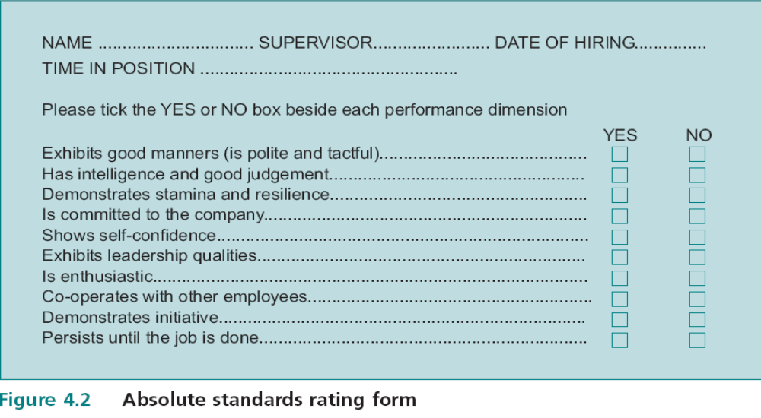
Absolute Standards

Slide 28
Performance Appraisal Methods Graphic Scales Rating System
Graphic rating scales are the most popular systems in use today.
The typical graphic rating scale form lists performance criteria which are meaningful to both the supervisor and employee.
The criteria possess content validity.
Using a numerical rating scale, the supervisor assigns a number to each criterion

Slide 29
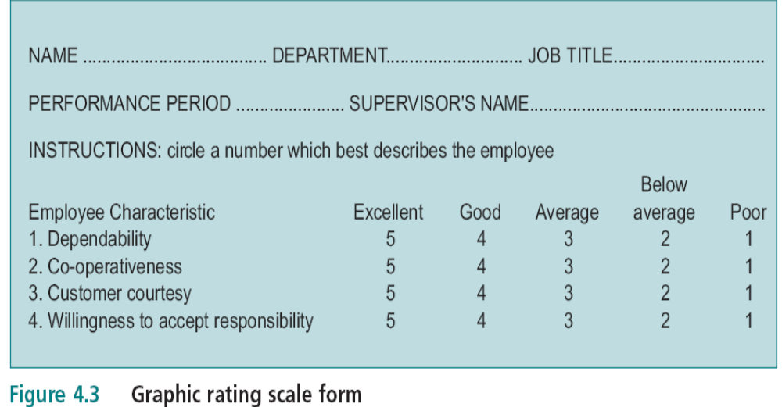
Graphic Scale Rating

Slide 30
Performance Appraisal Methods Graphic Scales Rating System
This method of rating employees highlights the differences in the performance of subordinates. Use of the system encourages the tendency to spread employees out along each scale.
Since degrees of performance success or failure are possible

Slide 31
Graphic Scales
Rating System
The graphic rating scale does not eliminate threats to validity .
Supervisors have a tendency to use only part of the rating scale because of individual supervisor strictness, leniency, or similarity.
Some organisations try to avoid this problem by requiring supervisors to generate a fixed distribution of performance levels.
Forced distributions can create problems for employees because they may conclude that the distribution is unfair.

Slide 32
Performance Appraisal Methods Behaviour Anchored Rating Scale (BARS)
This system provides concrete examples of behaviours for different levels of performance.
BARS systems emphasise work behaviour and how the work gets done instead of characteristics of employees.
The design and implementation of a BARS is an involved participative procedure which utilises the input of supervisors and employees .

Slide 33
Behaviour Anchored Rating Scale (BARS)
Employees are consulted during the design phase to identify critical work activities which lead to success or failure on the job
Each level of performance is defined in behavioural terms.
These are the behavioural anchors.
They provide examples of the possible behaviours related to a performance dimension.

Slide 34
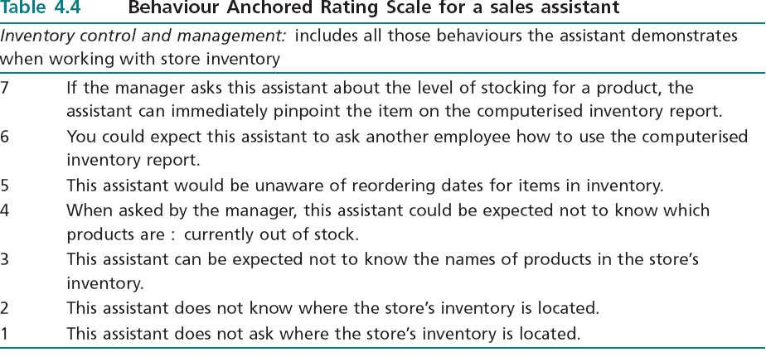
Behaviour Anchored Rating Scale (BARS)

Slide 35
How BARS Systems Differ from Other Methods
BARS systems emphasise how the work is performed (through the behavioural examples) versus the traits of employees.
BARS apply to a closely grouped, or specific set of tasks.
The quality of performance feedback from a BARS system may exceed the quality of feedback from other systems since the emphasis is on job behaviour.

Slide 36
How BARS Systems Differ from Other Methods
On the negative side, BARS systems take a long time to develop.
They work best when job behaviour is always observable.
Developing a BARS system for jobs which require creativity, intellectual curiosity, innovation, and complex problem solving is more difficult.
It would be difficult to develop BARS systems for the jobs of scientists, professors, lawyers, or physicians.

Slide 37
MBO
Edwin Locke, described the relationship between goals and work performance .
Goals are defined as those end states which reduce the intensity of needs and motives
Clearly specific, difficult goals result in
greater performance than general easy goals.

Slide 38
Goal Setting Systems
Increase work motivation and performance
Reduce the stress of conflicting or confusing expectations
Improve the accuracy and validity of performance evaluation .

Slide 39
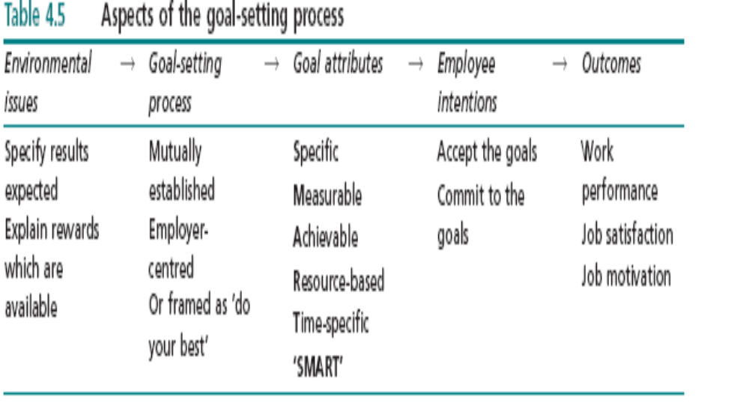
Goal Setting Process

Slide 40
Performance Feedback
Feedback is a highly important element for sustaining the focus of effort towards certain goal.
Organisations must incorporate well timed
formal and informal feedback that keeps managers and employees appraised of their progress .
Feedback is an important intrinsic reward for employees.

Slide 41
MBO
MBO is an application of goal-setting theory.
Peter Drucker. advocates MBO as a process which develops self-control in managers by controlling organizational and individual outcomes.
The mutual acceptance of goal increases the probability that the goal will be achieved and job satisfaction, performance and motivation will occur

Slide 42
WHY MBO
WHY GOAL-SETTING
Increase work motivation and employee job performance.
Reduce the stress of conflicting or confusing work expectations for employees.
Improve the accuracy and validity of performance evaluation work in the organization.

Slide 43
ASSUMPTIONS
OF MBO CYCLE
Employees perform better when they know what is expected of them.
Employees prefer self-determination at work.
Employees can be motivated by further well-timed formal and informal feedback .
Employees prefer intrinsic and extrinsic rewards that are consistent with their performance level.

Slide 44
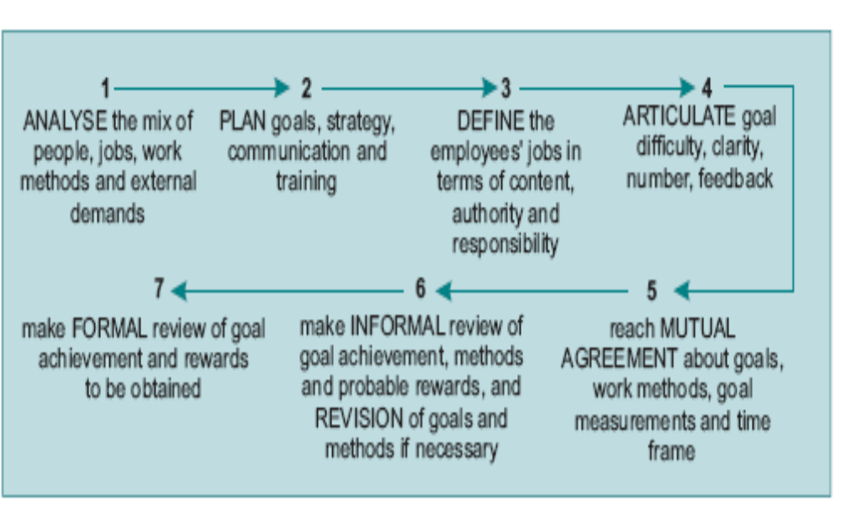
The MBO Cycle

Slide 45
THE 7 MBO STEPS
ANALYSE
The mix of people, jobs, work methods and external demands.
This is a strategic activity conducted by top level management.
2) PLAN
Goals strategy, communication and training

Slide 46
THE 7 MBO STEPS
3) DEFINE
The employees’ job in terms of content, authority and responsibility
4)ARTICULATE
goal difficulty, clarity, number, feedback

Slide 47
THE 7 MBO STEPS
MUTUAL AGREEMENT:
Reach mutual agreement about goals, work methods, goal measurements and time frame
6) INFORMAL REVIEW:
Make informal review of goals achievement, methods and rewards and revision of goals and methods if necessary
7) FORMAL REVIEW:
Make formal review of goal achievement and rewards to be obtained.

Slide 48
The Use of MBO Systems
1- Top management support, commitment and involvement.
2- MBO must have a strong relationship with managerial activities and responsibilities.
3- MBO must emphasise organisational and personal development goals.

Slide 49
The Use of MBO Systems
4-The firm must devote resources to the training of personnel
5-The firm must tailor the MBO system to meet the needs of departments.
6-Managers must avoid overemphasis on the number of goals. The ‘80–20 rule’ is good.

Slide 50
The Use of MBO Systems
7- The benefits of an MBO system should exceed the costs in terms of paperwork.
8- Equal emphasis should be placed on discussion and evaluation.
9- MBO should be flexible and goals can be adjusted to meet unforeseen circumstances.

Slide 51
5- JOB
MOTIVATION
SATISFACTION
1- REWARDS
4- EMPLOYEE
COMMITMENT
MBO
2- GOAL-
SETTING
PROCESS
3- GOAL
ATTRIBUTES
“SMART”
GOAL-SETTING THEORY

Slide 52

SMART OBJECTIVES
Specific
Measurable
Achievable
Rsource-based
Time-based

Slide 53
Rewards
Rewards strongly influence employee effort and performance levels.
The perceived equity of these comparisons leads to experienced levels of job satisfaction and motivation.
How the rewards are perceived can easily outweigh the actual rewards distributed by the firm.

Slide 54
CLASSIFYING REWARDS IN WOK SETTING
A. EXTRINSIC REWARDS
Extrinsic rewards are given to the employee by the organization.
Extrinsic rewards can be further broken down into direct compensation, indirect compensation and non-financial rewards.

Slide 55
CLASSIFYING REWARDS IN WOK SETTING
A. EXTRINSIC REWARDS
Direct compensation refers to extrinsic rewards which include
base salary
Bonus
holiday pay
stock options
pensions

Slide 56
CLASSIFYING REWARDS IN WOK SETTING
A. EXTRINSIC REWARDS
Indirect compensation refers to rewards that are given because of the employee’s organizational level rather than because of his performance.
Examples: top executive personal protection programs, loans at low interest rates, and time-off with pay.

Slide 57
CLASSIFYING REWARDS IN WOK SETTING
A. EXTRINSIC REWARDS
Non-financial compensation:
preferred office furniture
parking spaces
own secretary
impressive titles.

Slide 58
CLASSIFYING REWARDS IN WOK SETTING
B. INTRINSIC REWARDS
Intrinsic rewards are rewards which employees associate with the job itself.
These include more responsibility or interesting work, being included in the decision making process, opportunities for personal growth or doing
work which requires a number of skills and activities.

Slide 59
CLASSIFYING REWARDS IN WOK SETTING
B. INTRINSIC REWARDS
Examples of work with high levels of intrinsic rewards include doctors, politicians, judges and designers.( require several skills & activities)
The contrast in available intrinsic rewards is noticeable when you compare these professions with work done by employees in a car factory

Slide 60
CLASSIFYING REWARDS IN WOK SETTING
B. INTRINSIC REWARDS
intrinsic rewards are more important than extrinsic rewards in influencing motivation and performance.
Employees will value goal setting more if they know that participation in the process will lead to intrinsic and extrinsic rewards that they value.

Slide 61
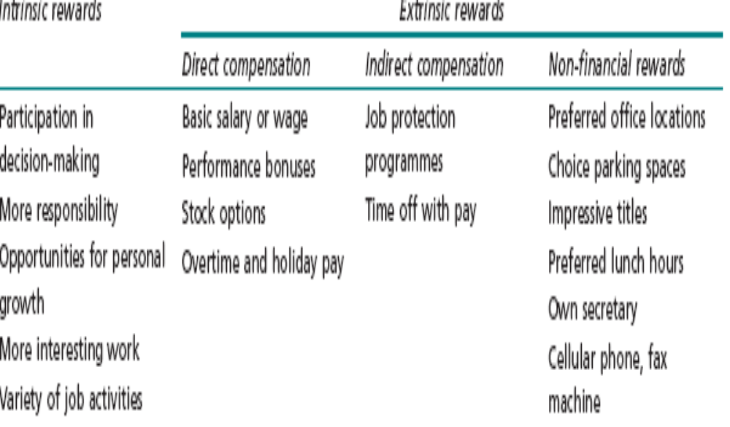
Intrinsic and Extrinsic Rewards in Organizations

Slide 62
DISTRIBUTING REWARDS, HOW?
1) PERFORMANCE
2) EFFORT
3) SENIORITY
4) EQUALITY
5) POWER AND INFLEUNCE

Slide 63
DISTRIBUTING REWARDS
1- PERFORMANCE
When rewards are allocated on this basis, then performance becomes a motivator.

Slide 64
DISTRIBUTING REWARDS
2- EFFORT
In order to minimize turnover and hiring costs, organizations frequently decide to rewarded effort.
This is done to prevent employee from experiencing job dissatisfaction.
Managers reward efforts in the hope that efforts will be followed by actual performance.

Slide 65
DISTRIBUTING REWARDS
2- EFFORT
This is a non-performance basis for allocating rewards.
If the practice is widespread, high performers may experience reduced satisfaction with pay because they believe the organization is neglecting to reward their proven abilities to produce.

Slide 66
DISTRIBUTING REWARDS
3- SENIORITY
Length of service is used to group employees.
When seniority becomes a substitute for performance in the allocation of rewards, the organization soon learns it is encouraging tenacity rather than performance.
This eliminates perceived equity for high performers who leave the organization .

Slide 67
DISTRIBUTING REWARDS
4- EQUALITY
This policy of compensation means that employees at given organizational levels receive the same base pay and pay rises. This is common in partnership.

Slide 68
DISTRIBUTING REWARDS
5- POWER AND INFLUENCE
Groups or individuals are able to increase their share of rewards at the expense of other groups or individuals.
it is a focal concern to unions which wish to preserve their economic capacity to influence employers’ decision.

Slide 69
Job Classification Scheme for
Rewarding System
How do firms determine the value of their jobs?
Skills requirements e.g. training & education
2) Mental abilities as intellectual &emotional demands of job, problem solving, decision making
3) Physical requirements e.g. health, stamina
4) Responsibility e.g. number of people& budget size.
5) Working conditions e.g. noise, humidity, vibration

Slide 70
Job Classification Scheme
for Rewarding System
Rating Factors for Jobs
A typical classification system rates the jobs in cluster of jobs on the reward factors.
Points for each factor might be assigned by a panel
The points would be accumulated for each job and then totaled & compared to compensation surveys.
Importance of an objective basis for distributing rewards based on the job’s demands.

Slide 71
Components of Executive Compensation
The effectiveness of executives is measured by the rising market valuations of the companies that they head.
Their pay packages reflect industry practices and the compensation programmes of rival firms .
A pattern of uniformity exists among the industries in terms of executive pay.

Slide 72
Components of Executive Compensation
There are four basic components of executive compensation:
1) Base salary
2) Benefits
3) Long term incentives
4) Annual bonus

Slide 73
Components of Executive Compensation
Base salary is determined by a committee at the directorate level.
The compensation committee reviews executive salary data for firms of comparable size both inside and outside the industry to arrive at an amount for executives’ base salaries.
Annual bonuses are designed to motivate executives to maximise net income.
CEOs earned bonuses in U.S in 1995 were 255 percent of their base pay.

Slide 74
Components of Executive Compensation
The third component of executive compensation is long term incentives or the incentive stock option (ISO)
The executive is granted the right to purchase a number of shares of company stock at a price over a specified period of time.
The incentive is to maximise the value of the shares so that exercising the option yields a substantial profit .

Slide 75
Components of Executive Compensation
The fourth component of executive compensation is executive benefits.
Executives receive higher benefits .
Executives receive higher contributions to their life insurance, disability insurance, pensions and co-payments for health care costs.

Slide 76
The Current Trends in Executive Compensation?
Trend 1: Strengthening the link between executive compensation and the market value of firms.
Corporate officers encourage their boards to support corporate diversification to spread business cycle risk over a portfolio of company subsidiaries.
While the corporation may be no more profitable once it’s diversified, the Executives are paid more because the size of the company is a much better predictor of executive compensation than is its profitability.

Slide 77
The Current Trends in Executive Compensation
Trend 2: Executive compensation rises much faster than employee wages.
The heads of 30 major US corporations received compensation that was 212 times higher than the pay of the average American employee.

Slide 78
The Current Trends in Executive Compensation
Trend 3: CEO pay rises much faster than the pay of the second in command.
A Fortune study of 500 US companies in the 90s found that the pay of CEOs rose an average of 237 percent.
In the same companies, the average compensation of chief operating officers rose a more modest 88 percent.

Slide 79
The Current Trends in Executive Compensation
Trend 4: Pay gaps between American and British executives narrow.
Trend 5: More emphasis on the firm’s net income.
Corporate boards are placing more emphasis on the firm’s earnings, which accents the executive’s annual bonus versus his annual base salary.

Slide 80
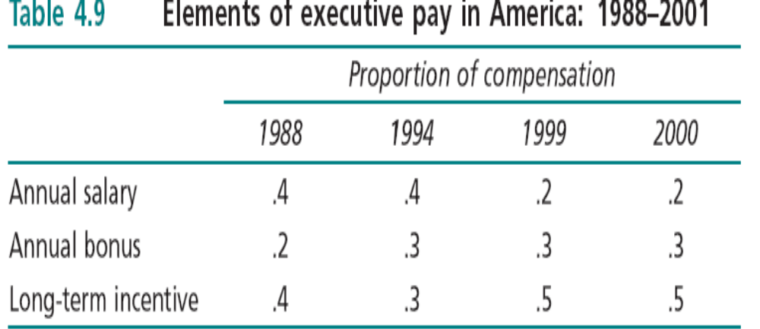
The Current Trends in Executive Compensation

Slide 81
The Current Trends in Executive Compensation
Trend 6: Preventing ISO plans from diluting stock value.
Large companies now have ownership guidelines for
executives who receive stock as compensation. Examples of such guidelines include:
1) executives must buy stock when the price goes down,
2) executives must sell stock when it reaches a threshold value
3) they must hold stock when dramatic fluctuations in value occur
4) a non complete callback Provision which prevents a CEO from selling his shares until a predetermined time after leaving the firm (prevents disgruntled CEOs from financing a startup Competitor with the profits from selling the stock of his previous employer).

Slide 82
Effect of Downsizing & Delayering on Compensation Plans?
The most common and effective method to manage compensation costs is the continued reduction in the size of merit increases awarded to employees.
Reduction of merit increases and greater reliance on pay for performance (bonuses) across companies and industries has the effect of slowing the growth in costs of benefits programmes.

Slide 83
Effect of Downsizing & Delayering on Compensation Plans?
Since pay for performance is a component of the annual bonus for employees, these payments do not drive up the company’s contributions to their employees’ pension plans.
If employees fail to meet goals in the following year, the annual bonus disappears, unlike merit pay increases which become a permanent component of base pay.

Slide 84
Effect of Downsizing & Delayering on Compensation Plans?
Uncoupling merit pay and cost of living (COLs) increases is also on the rise as a compensation scheme in delayered and downsized firms.
De-layered and downsized firms are also exhibiting more reliance on pay for performance.
Annual bonuses are making their way down the chain of command.

Slide 85
Effect of Downsizing & Delayering on Compensation Plans?
Delayered and downsized firms rely more on part time employees and temporary workers.
Companies use this practice to reduce recruiting, selection and training costs.

Slide 86
PAY PRACTICES
Cafeteria-style fringe benefits
Lump-sum pay
Skilled-based compensation
Accumulating time off
The all-salaried team
Open-salary information

Slide 87
PAY PRACTICES
Cafeteria-style fringe benefits:
Tthe employees select a package of fringe benefits designed for their individual needs.
It is called flexible benefits packages.
Some employees take all of the fringes in cash while others purchase other benefits consistent with their needs.

Slide 88
PAY PRACTICES
Lump-Sum Pay Systems:
These plans allow employees to decide how they receive their pay during the coming year.
Plans range from weekly pay to one large cheque at the beginning of the year.
N.B This is not a good system for organizations with cash flow problems.

Slide 89
PAY PRACTICES
Skill-Based Compensation
They reward employees for learning new skills.
These systems provide pay rises and bonuses for the gained number of new skills employees can master.
It is more important in organizations using self-managed teams.

Slide 90
PAY PRACTICES
Accumulating Time Off:
The time-off feature is attractive to most employees.
The concept is to determine days off with pay based on seniority or performance.
Employees are allowed to accumulate time-off credits. These credits can be “turned in” for time off with pay.

Slide 91
PAY PRACTICES
The All-Salaried Team:
In some organizations, executives and managers are paid salaries while non-managers receive hourly wages.
By paying all employees a salary, the organization improve loyalty and commitment & team work is promoted

Slide 92
PAY PRACTICES
Open-Salary Information:
Pay secrecy can obscure the actual relationship between performance and reward (Equity Theory)
Employees overestimate the pay of their superiors and underestimate their rewards.
Pay secrecy exaggerates pay perception and create a chronic condition of perceived disruptive injustice.

Slide 93
Company Pay Plans
Skilled-based compensation.
Does the plan capture the attention of the employee?
Do employees understand the elements of the plan?
Does the plan improve communication?
Is the company performing better as a result of the plan?

Slide 94
Guidelines for Incentive Plan
Incentives in the reward system should be tied to actual performance on the job. (relationship between performance and reward)
2. The incentive system and benefits programs should be adjusted to individual differences among employees (e.g. Flex time, parental leave, care of dependents and educational benefits)

Slide 95
Guidelines for Incentive Plan
3-the System should be consistent with the culture.
4-Incentives should match the type of work.
5-Any incentive system should be monitored over time to ensure that employees are being paid at the prevailing levels for their work and that they are being fairly treated.

Slide 96
Group-Based Reward Systems
Company goals depend on teamwork and collaborative employee effort.
Group based reward systems encourage teamwork and collaborative work activity.
Managers must ensure that the group aspects of performance are equitably rewarded
Cost-Savings Plans
Profit-Sharing Plans

Slide 97
Group-Based Reward Systems
A- Cost-Savings Plans
1 - The Scanlon Plan
2 - The Rucker Plan

Slide 98
A- Cost-Savings Plan
1- The Scanlon Plan
The plan tries to reduce labour costs below a historic base level.
Groups are motivated by bonuses, which are contingent on reducing the costs of factors of production below established base rates.
The Plan promotes a work climate with better labour management cooperation and improved group based innovation and problem solving.

Slide 99
Cost-Savings Plan
The Scanlon Plan
Scanlon Plans can also be called gain sharing plans because the gains associated with cost savings are shared between the owners of the company and labor.
Usually the bonus is 25-50 per cent of the savings made during the first year of the innovation.
Gain sharing programmes are extremely powerful tools for lowering costs and building innovation .
The plan is a powerful motivational system.

Slide 100
The Scanlon Plan
A company may have several production committees which focus on finding ways to improve productivity in their areas of work responsibility.
The productivity suggestions made by these committees are then reviewed by a screening committee composed of managers, higher level executives, and skilled laborers.

Slide 101
The Scanlon Plan
If suggestions which produce cost savings or productivity improvements are implemented, all affected work groups receive bonuses for a specific period of time.
Gain sharing programs are extremely powerful tools for lowering costs , building innovation ,increased employee satisfaction and lowered turnover.

Slide 102
The Scanlon Plan
There are some important points to consider before a gain sharing programme is introduced.
1 - Gain sharing programmes work best when a dependable history of labour costs exists in the firm.
2 - Seasonal product demand makes gain sharing programme establishment more difficult since base production rates will vary because of the seasonality.
3 - The market may have to absorb additional output if the reduction in costs leads to an expansion of output.

Slide 103
The Scanlon Plan
4 - The company should have a history of labour–management cooperation.
5 - The programmes are easy to establish in production units with between 30 and 500 employees.
6 - Top management must be committed to the concept of productivity enhancement.

Slide 104
Strengthening Competitive Advantage by Using Team-based Rewards
Using an effective reward system in a self directed teamwork environment is enhanced by:
1) Superior customer service
2) Enhanced delayering and employee empowerment
TQM and reduced cycle time
4) Employee skill building and cross training
5) Features of workforce diversity.

Slide 105
Team Based Reward System & Competitive Advantages
Team based reward system can strengthen competitive advantage in six ways:
1- Attraction and retention.
  Excellent incentives attract and hold the best people and employees report high levels of job satisfaction and a lowered turnover.
2 - Skill development.
  Rewards are tied to cross training and skill building,

Slide 106
Team Based Reward System & Competitive Advantages
3 - Motivation and Performance.
  Timely and attractive incentives increase employees’ beliefs that they can perform well and they become more optimistic that a high level of effort lead to excellent performance.
4- Organisational Culture.
  Linking incentives to key company values can create a source of competitive advantage. Incentive are strongly related to motivation, performance and job satisfaction and they are a big part of organisational culture

Slide 107
Team Based Reward System & Competitive Advantages
5- The reinforcement & definition of structure.
  More companies are using stock options and forms of pay at risk to motivate self directed teams.
6 - Cost.
  The pay at risk concept reflects this principle because bonuses for individuals and their teams are a function of their level of achievement of strategic goals.

Slide 108
The Rucker Plan
A group incentive system that works in a self-directed team environment
The measurement of productivity is called the value added which is the difference between the sales income from goods produced and the cost of the materials.
It is considered as a cost saving & gain sharing Program.
Rucker Plan teams have a strong motive to increase their productivity

Slide 109
The Rucker Plan
Steps
1 - Identify a base period that provides valid and useful data for establishing standards.
The base period should be a reliable indicator of typical performance.
2 - Generate the following data using the base period standards.
  (a) Sales value of production (SVP)
  (b) Cost of materials. (COM)
  (c) Cost of labor (COL)

Slide 110
The Rucker Plan
3- Using these data, establish the following standards.
Value added
(VA) = SVP − COM
(b) Labour contribution to VA
(LCVA) = COL / VA
(c) Economic productivity index
(EPI) = 1.00 / LCVA
(d) Expected value of production
(EVP) = EPI × COL (for the bonus period)

Slide 111
The Rucker Plan
75 % of the bonus is paid monthly to employees and the remaining 25 % is held until year’s end.
This reserve provides a cushion for periods when teams fail to meet the standard.
After a year end , all reserve funds are distributed to employees.

Slide 112
Scanlon Versus Rucker Plan
1- The Rucker Plan measures profit in terms of the value added by factors of production .
2 -The Plan stresses the use of problem solving at the team level which fits with empowerment in delayered and downsized firms.
3 -The Rucker Plan is less rigid than the Scanlon Plan which requires use of committees.
4 -The lower level of hierarchical control in a Rucker Plan (no screening or production committees as in the Scanlon Plan) shorten the cycle time for evaluation.

Slide 113
The Rucker Plan Advantages
Teams can raise the sales value by improving product designs and process effectiveness.
They can use product development to synchronize marketing, production, financial control and R&D to shorten product development cycles.

Slide 114
The Rucker Plan Advantages
The firm’s cost of materials (COM in the Rucker Plan) can be influenced by self directed teams.
All expenditures on materials, supplies and services are subject to review and control.
The firm competes more effectively through lowered prices and superior product designs .
Teams members can see how their efforts and performance are tied to incentives.

Slide 115
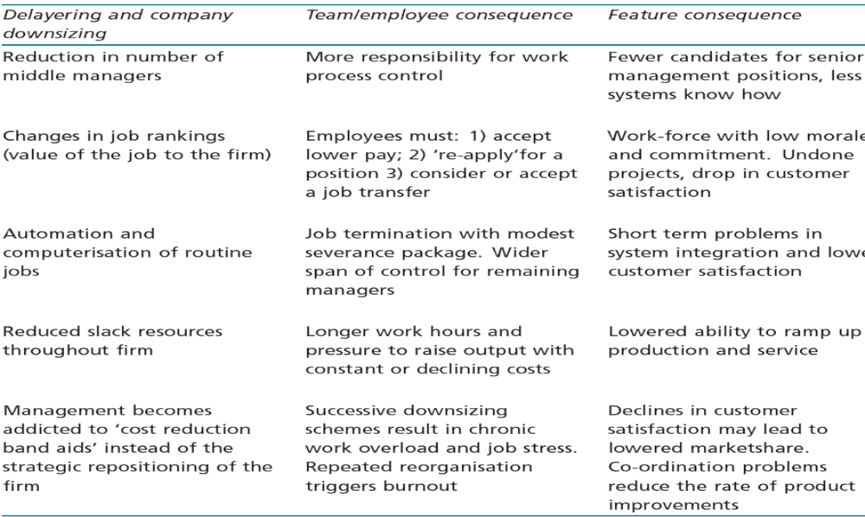
Consequences of Downsizing and Delayering

Slide 116
Consequences of Downsizing and Delayering
Downsizing and delayering disrupt the attainment of the lower order need satisfaction by affected employees and managers.
This triggers rapid rises in job dissatisfaction among them.
Job stress, job burnout, low morale, economic and job insecurity, depression and feelings of worthlessness become chronic symptoms of employees exposed to repeated bouts of downsizing and delayering.

Slide 117
Design and Timing Issues for the Installation of a Rucker Plan in a
Delayered Firm
Self directed teams have the authority to create and install improvements which raise the sales value of output or lower the costs of goods.
To be successful, a Rucker Plan needs to be established in a firm that practice empowerment
Installing a Rucker Plan is an end stage activity in a firm’s effort to build a new and sustainable source of competitive advantage.

Slide 118
Downsizing and Delayering and The Rucker Plan
Downsizing and delayering disrupt the attainment of the lower order need satisfaction by employees & managers & increase job dissatisfaction, stress, burnout, low morale & insecurity
Despite the introduction of empowerment programs and creation of self directed teams, there is a period of declining productivity after downsizing and delayering .

Slide 119
Downsizing and Delayering and The Rucker Plan
These conditions are unfavorable for the promotion and installation of group based incentive systems like the Rucker Plan.

Slide 120
Downsizing and Delayering and The Rucker Plan
If a firm has downsized and delayered, the following conditions should be met before a Rucker or gainsharing plan is installed.
1- The firm has returned to profitability.
2- The management team is stable.
3- Self directed teams are working and members have completed training in TQM, process control, and team building.
4- The company is not being positioned for sale.
5- Outsourcing of nonessential functions has been completed.
6- The firm is using service driven and market based measures of customer satisfaction.

Slide 121
The Rucker Plan
A start up company or addition of a new facility is a unique opportunity to make a Rucker Plan a basic feature of its employment relationship.
All personnel and operating decisions can be guided by the use of self directed teams, employee empowerment, a lean organisational structure and a service driven business model.

Slide 122
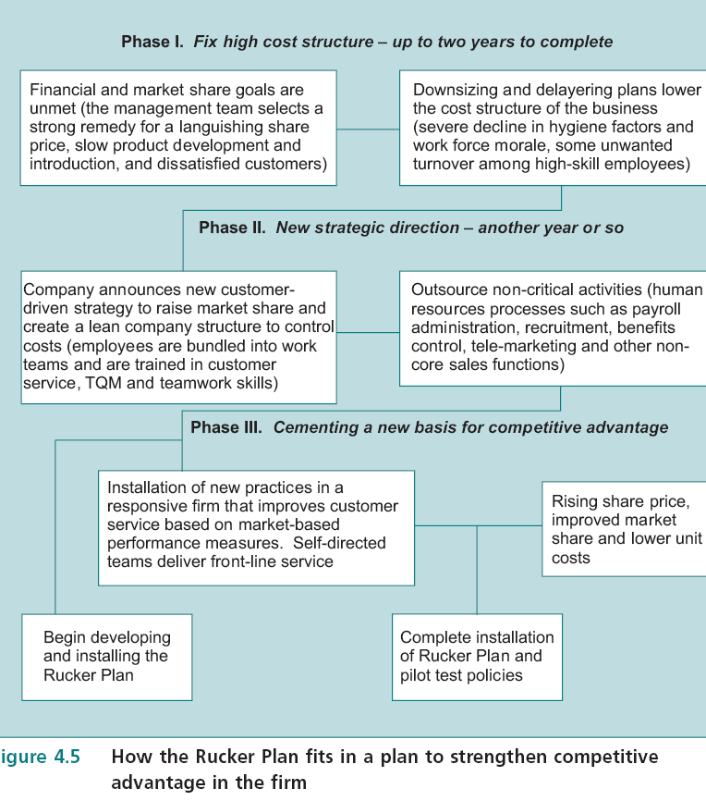

Slide 123
Profit-Sharing Plans
All employees contribute to the success of the firm, so all should share in the increased profits.
When sales are strong and costs are stable, organizations do well financially & apply it.
Profit sharing programs may be short lived when inventory increase , sales flatten, costs rise and profits fall.

